Slide 1
ASO Workshop
John Curran
Chair NRO EC, President & CEO ARIN
ICANN 43
San Josė, Costa Rica
14 March 2012

Slide 2
Agenda
About the ASO
ASO Review Report
Global Policy Update
Regional Policy Update
Internet Number Resource Status Report
IPv4 free pool exhaustion
Update on outreach and education activities

Slide 3
About the ASO
John Curran
Chair NRO EC, President & CEO ARIN
ICANN 43
San Josė, Costa Rica
14 March 2012

Slide 4
About the ASO
Address Supporting Organization (ASO)
  Function performed by the NRO
ICANN supporting organization
Purpose:
  Recommendations on Internet number resources
  Appoint Seats 9 and 10 to ICANN Board
  Appoint individuals to ICANN bodies
    NomCom 2012 — Hartmut Glaser (LACNIC)
    SSR Review Team — Hartmut Glaser (LACNIC)
    WHOIS Policy Review Team — Wilfried Woeber (RIPE)

Slide 5
ASO Executive Council
Members Chief Executives of five RIRs
  NRO Executive Council
Office Bearer positions rotate annually
2012 Members
  Chairman: John Curran (ARIN)
  Secretary: Paul Wilson (APNIC)
  Treasurer: Adiel Akplogan (AfriNIC)
  Member: Axel Pawlik (RIPE NCC)
  Member: Raúl Echeberría (LACNIC)

Slide 6
What is the NRO?
Number Resource Organization
  Vehicle for RIR cooperation and representation
Formed for the purposes of:
  protecting the unallocated Number Resource pool
  promoting and protecting the bottom-up policy development process
  acting as a focal point for Internet community input into the RIR system
Fulfills the role, responsibilities and functions of the ASO within ICANN framework
  By ICANN/ASO MoU signed on 21 October 2004

Slide 7

RIR Regions

Slide 8
RIR Structure
IANA
AfriNIC
APNIC
ARIN
LACNIC
RIPE NCC
Member
NIRs
Member
Member
Member
Member
Member
Member

Slide 9
ASO / NRO
NRO expenses distribution 2011
  Weighted formula (being currently reviewed) based on revenue and total number resources held:
    AfriNIC (4.14%)
    APNIC (37.50%)
    ARIN (18.17%)
    LACNIC (6.86%)
    RIPE NCC (33.45%)
NRO contribution to ICANN
  The NRO remains committed to a yearly contribution of $823,000.

Slide 10
ASO Address Council
Function performed by NRO Number Council
15 Community Members
  3 from each RIR Region
    2 Elected at Large (2 year term)
    1 Appointed by RIR Board (1 year term)
Responsibilities
  Advise ICANN Board
  Select ICANN Board Members (2)
  Appoint members to ICANN bodies:
    NomCom, AoC Review Teams

Slide 11
The Address Council
Comprised of 15 elected and appointed individuals from all 5 regions
Independent body separate from RIR management and board to:
  Oversee global number resource policy work
  Appoint 2 Directors to the ICANN Board
  Serve on various ICANN bodies as needed:
  (e.g. ICANN Nominating Committee, Affirmation of Commitment Review Teams)
  Advise ICANN Board on number resource matters

Slide 12




Registry | Member
 | Alan Barrett* [Vice Chair]
 | Douglas Onyango
 | Fiona Asonga
 | Andy Linton*
 | Naresh Ajwani
 | Tomohiro Fujisaki
 | Jason Schiller
 | Ron da Silva*
 | Louis Lee [Chair]
 | Sebastian Bellagamba
 | Hartmut Glaser*
 | Alejandro Guzman
 | Dave Wilson [Vice Chair]
 | Hans Petter Holen
 | Wilfried Woeber*

Slide 13
ICANN Board Selection
Seat Nine selection schedule
  Nomination Phase 1 November 2011 to 16 January 2012
  Comment Phase 17 January 2012 – 19 April 2012
  Interview Phase 20 February 2012 – 19 April 2012
  Selection Phase 23 April 2012 -14 May 2012
  Due Diligence Review 15 May 2012 – 15 June 2012
Selection Announced 18 June 2012
  (or earlier based on completion date of due diligence review)
Candidates:
  Thomas Eric Brunner-Williams
  Martin J. Levy
  William Manning
  Raymond Alan Plzak

Slide 14
Thank you.
Questions?

Slide 15
Independent Review of
ICANN ASO
John Curran
Chair NRO EC, President & CEO ARIN
ICANN 43
San Josė, Costa Rica
14 March 2012

Slide 16
Independent Review of
ICANN ASO
Request for Proposal
  ITEMS International, a Paris-based consultancy firm specialized in strategic consulting in the areas of telecommunications and the Internet
Aims
  Assess how well the ASO performs within the ICANN system
  Determine whether any change in its structure or operations is desirable
Conducted between July and December 2011
  A global survey
  Individual interviews

Slide 17
Thank you.
Questions?

Slide 18
Global Policy Update
Status of GPP-IPv4-2011

Slide 19
Global Policy Process
Global Policies
Regional Policies
AfriNIC
APNIC
Regional Communities
ARIN
NRO
ASO
ICANN
LACNIC
RIPE NCC
Policy-making Community
Facilitators

Slide 20
ASO AC: GPP-IPv4-2011
“Global Policy Proposal for Post Exhaustion IPv4 Allocation Mechanisms by IANA”
Recognized by ASO AC as GPP candidate 3 February 2011
Describes how IANA will allocate IPv4 resources now central pool is exhausted
  Establish a Recovered IPv4 Pool
  Remaining fragments and returned space
  1/5 of Recovered IPv4 Pool to each RIR every IPv4 Allocation Period (6 months)

Slide 21
Ratification Phase
GPP Process defined by ASO MOU
  http://www.icann.org/en/aso/aso-mou-29oct04.htm
Attachment A - GPDP
  http://www.icann.org/en/aso/aso-mou-attachmentA-29oct04.htm
Ratification Phase
  NRO EC transmits to ASO AC
  Address Council Review
  ICANN Board Ratification

Slide 22
ASO Address Council Review
ASO AC Operating Procedures
  http://aso.icann.org/documents/operating-procedures-aso-ac/
Policy Proposal Facilitator Team (PPFT)
Within sixty (60) days AC will either
  Pass to ICANN for ratification as a global policy;
  Advise the NRO EC of any concerns; or
  Request the NRO EC for a time extension

Slide 23
Thank you.
Questions?

Slide 24
Regional Policy Update
Louie Lee
Chair, ICANN ASO Address Council
ICANN 43
San Josė, Costa Rica
14 March 2012

Slide 25
APNIC Policy Update
Under Discussion
  prop-101 Removing multihoming requirement for IPv6 portable assignments
  prop-099 IPv6 Reservation for Large Networks
In Final Call
  prop-102 Sparse allocation guidelines for IPv6 resource allocations
Pending Implementation
  prop-097 Global policy for post exhaustion IPv4 allocation mechanisms by the IANA

Slide 26
AfriNIC Policy Update
Recently Approved
  AFPUB-2011-v4-004 (GPP-IPv4-2011)
    Global Policy for Post Exhaustion IPv4 Allocation Mechanisms by the IANA
  AFPUB-2010-v4-005
    IPv4 Soft Landing Policy
      Changes IPv4 policies to deal with exhaustion
      Maximum size of each allocation or assignment is reduced, first to /13 and later to /22
      Time window used for planning purposes is reduced
      A /12 is reserved for unforeseen purposes
  AFPUB-2010-GEN-006
    Abuse Contact Information in the AfriNIC service region
      Adds a way of recording abuse contact information in WHOIS data

Slide 27
AfriNIC Policy Update
Expired
  AFPUB-2011-v4-002
    Reclamation of Allocated but Un-routed IPv4 Addresses
  AFPUB-2011-v4-001
    Transfer of IPv4 Addresses to Any Entity
  AFPUB-2010-GEN-007
    Addition of Real Contact Email into ASN Whois Bulk Data
  AFPUB-2010-v4-003 (GPP-IPv4-2010)
    Global Policy for IPv4 Allocations by the IANA Post Exhaustion
Under Discussion
  (none)

Slide 28
ARIN Policy Update
Under Discussion
  ARIN-2011-1: ARIN Inter-RIR Transfers
  ARIN-2011-7: Compliance Requirement
  ARIN-2012-1: Clarifying requirements for IPv4 transfers
  ARIN-2012-2: IPv6 Subsequent Allocations Utilization Requirement
  ARIN-2012-3 ASN transfers
  ARIN-2012-4 Return to 12 Month Supply and Reset Trigger to /8 in Free Pool

Slide 29
ARIN Policy Update
Awaiting Further Developments
  ARIN-2011-5: Shared Transition Space for IPv4 Address Extension
  ARIN-2011-9 (Global Proposal): Global Policy for post exhaustion IPv4 allocation mechanisms by the IANA

Slide 30
LACNIC Policy Update
Under Discussion
  LAC-2011-07 Modification of Policy 2.3 IPv4 Address Allocation and Assignment Policies
  LAC-2011-08 Including ROA data in the Whois database when available
  LAC-2011-09 Modification of the requirements for the initial assignment of IPv4 addresses to end users
  LAC-2012-01 Eliminate the use of the term "dial-up”
  LAC-2012-02 Registering assignments

Slide 31
LACNIC Policy Update
Recently implemented:
  LAC-2011-03 Modification of Section 2.3.4 - Policies for the Distribution of Additional IPv4 Address Space
  LAC-2011-04 Add line 6 to Section 11.1 of the Policy Manual on IPv4 address exhaustion
  LAC-2011-06 Distributions / Allocations for a smooth finish of IPv4 resources

Slide 32
RIPE NCC Region
Under Discussion
  2011-04, Extension of the Minimum Size for IPv6 Initial Allocation
  2011-05,Safeguarding future IXPs with IPv4 space
  2011-06, Abuse Contact Management in the RIPE NCC Database

Slide 33
Summary of Current Proposals
IPv4 policies: allocation, reclamation, transfer (6)
  ARIN (3), LACNIC (2), RIPE (1)
IPv6 address allocation policies (4)
  APNIC (2), ARIN (1), RIPE (1)
Whois, registration change policies (2)
  LACNIC (1), RIPE (1)
ASN Transfers (1)
  ARIN (1)
Other, compliance, documentation (3)
  APNIC (1), ARIN (1), LACNIC (1)
Total: 17 policies

Slide 34
Participation is Easy!
Subscribe to the RIR policy list(s)
  No membership requirements
Attend RIR meetings
  In person (open, free or nominal fee)
  Remote (free)
Upcoming Meetings
  RIPE 64, Ljubljana, Slovenia, 16-20 April 2012
  ARIN XXIX Vancouver, British Columbia, 22-25 April 2012
  LACNIC XVII Quito, Ecuador, 6-11 May 2012
  AfriNIC-16: Serekunda, Gambia 12-18 May 2012
  APNIC 34 Phnom Penh, Cambodia 21 – 31 August 2012

Slide 35
Thank you.
Questions?

Slide 36
Internet Number Resource Status Report
As of 30 December 2011
Prepared by
Regional Internet Registries
AfriNIC, APNIC, ARIN, LACNIC and the RIPE NCC

Slide 37
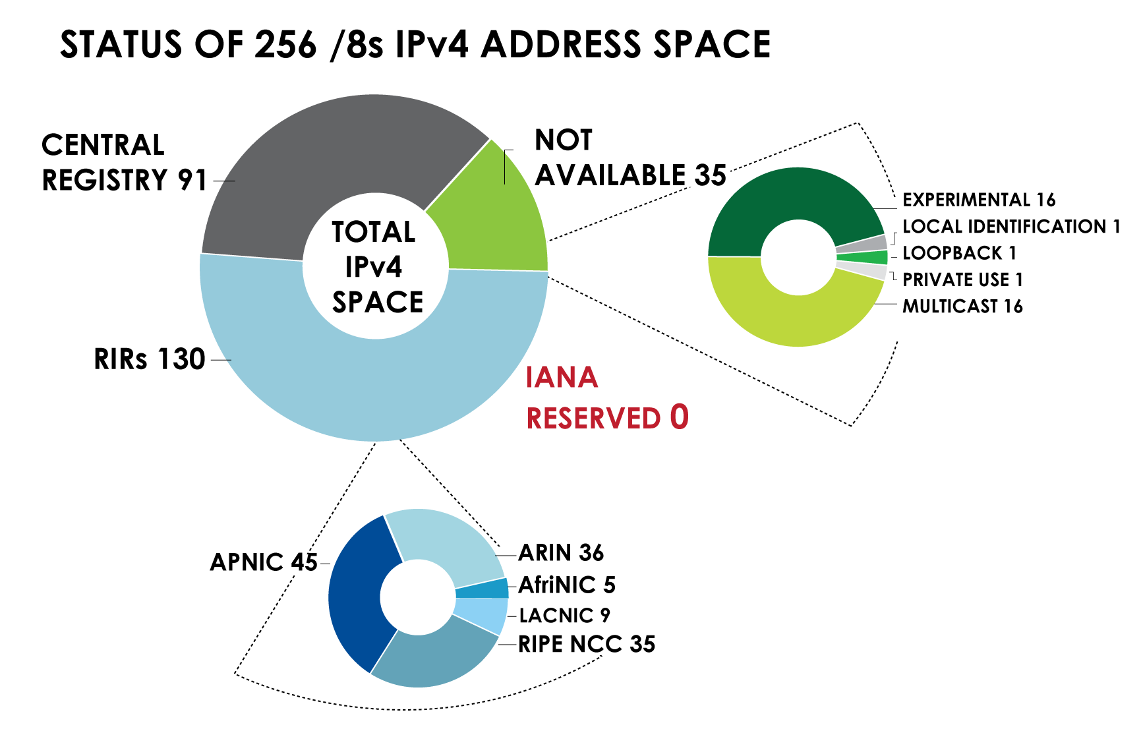
IPv4 ADDRESS SPACE
What is the status of each of the 256 /8s?

Slide 38
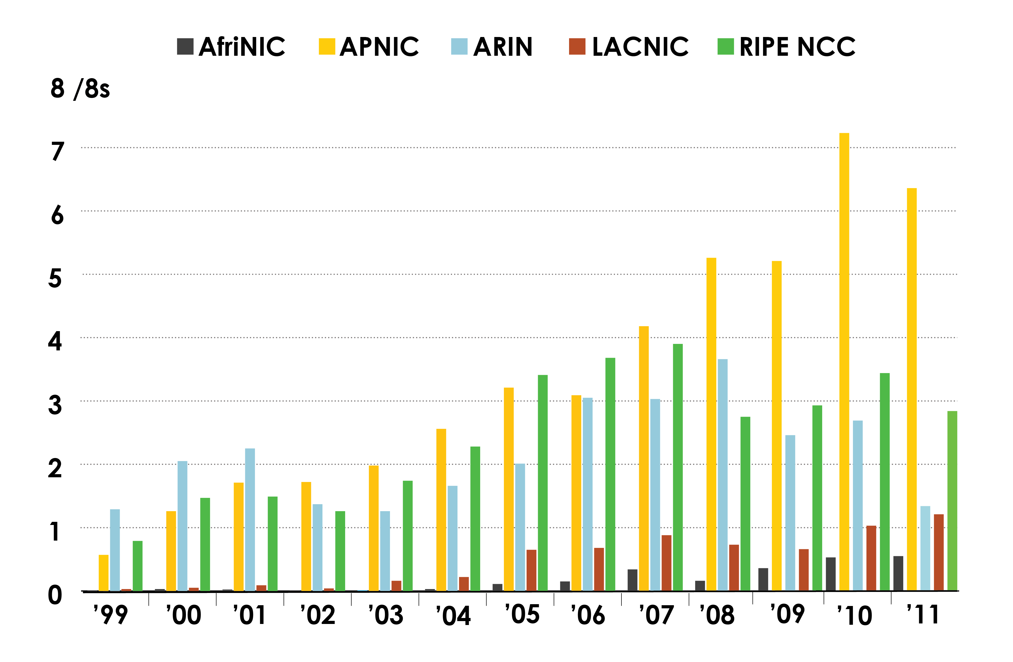
IPv4 ADDRESS SPACE ISSUED
(RIRs TO CUSTOMERS)
In terms of /8s, how much space did each RIR issue by year?

Slide 39
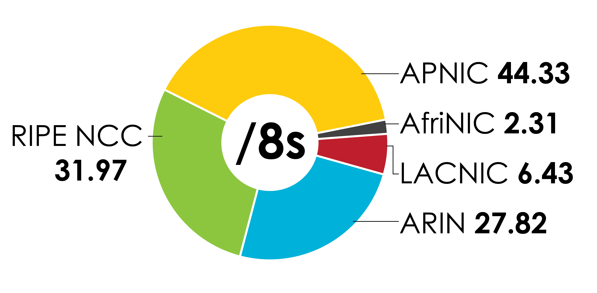
IPv4 Address Space Issued
(RIRs TO CUSTOMERS)
In terms of /8s, how much total space has each RIR issued?
(Jan 1999 – Dec 2011)

Slide 40
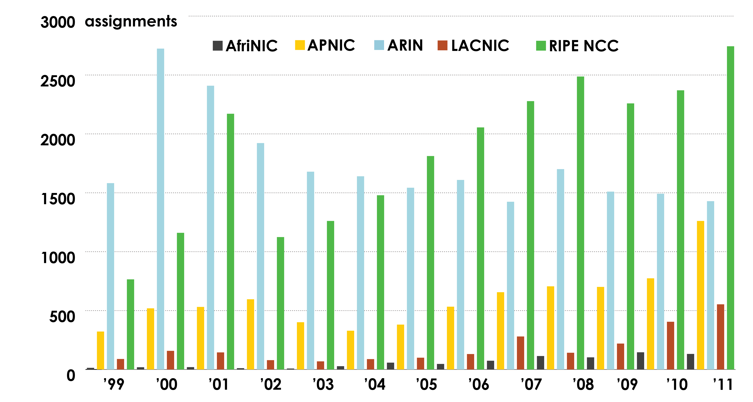
ASN ASSIGNMENTS (RIRs TO CUSTOMERS)
How many ASNs has each RIR assigned by year?

Slide 41
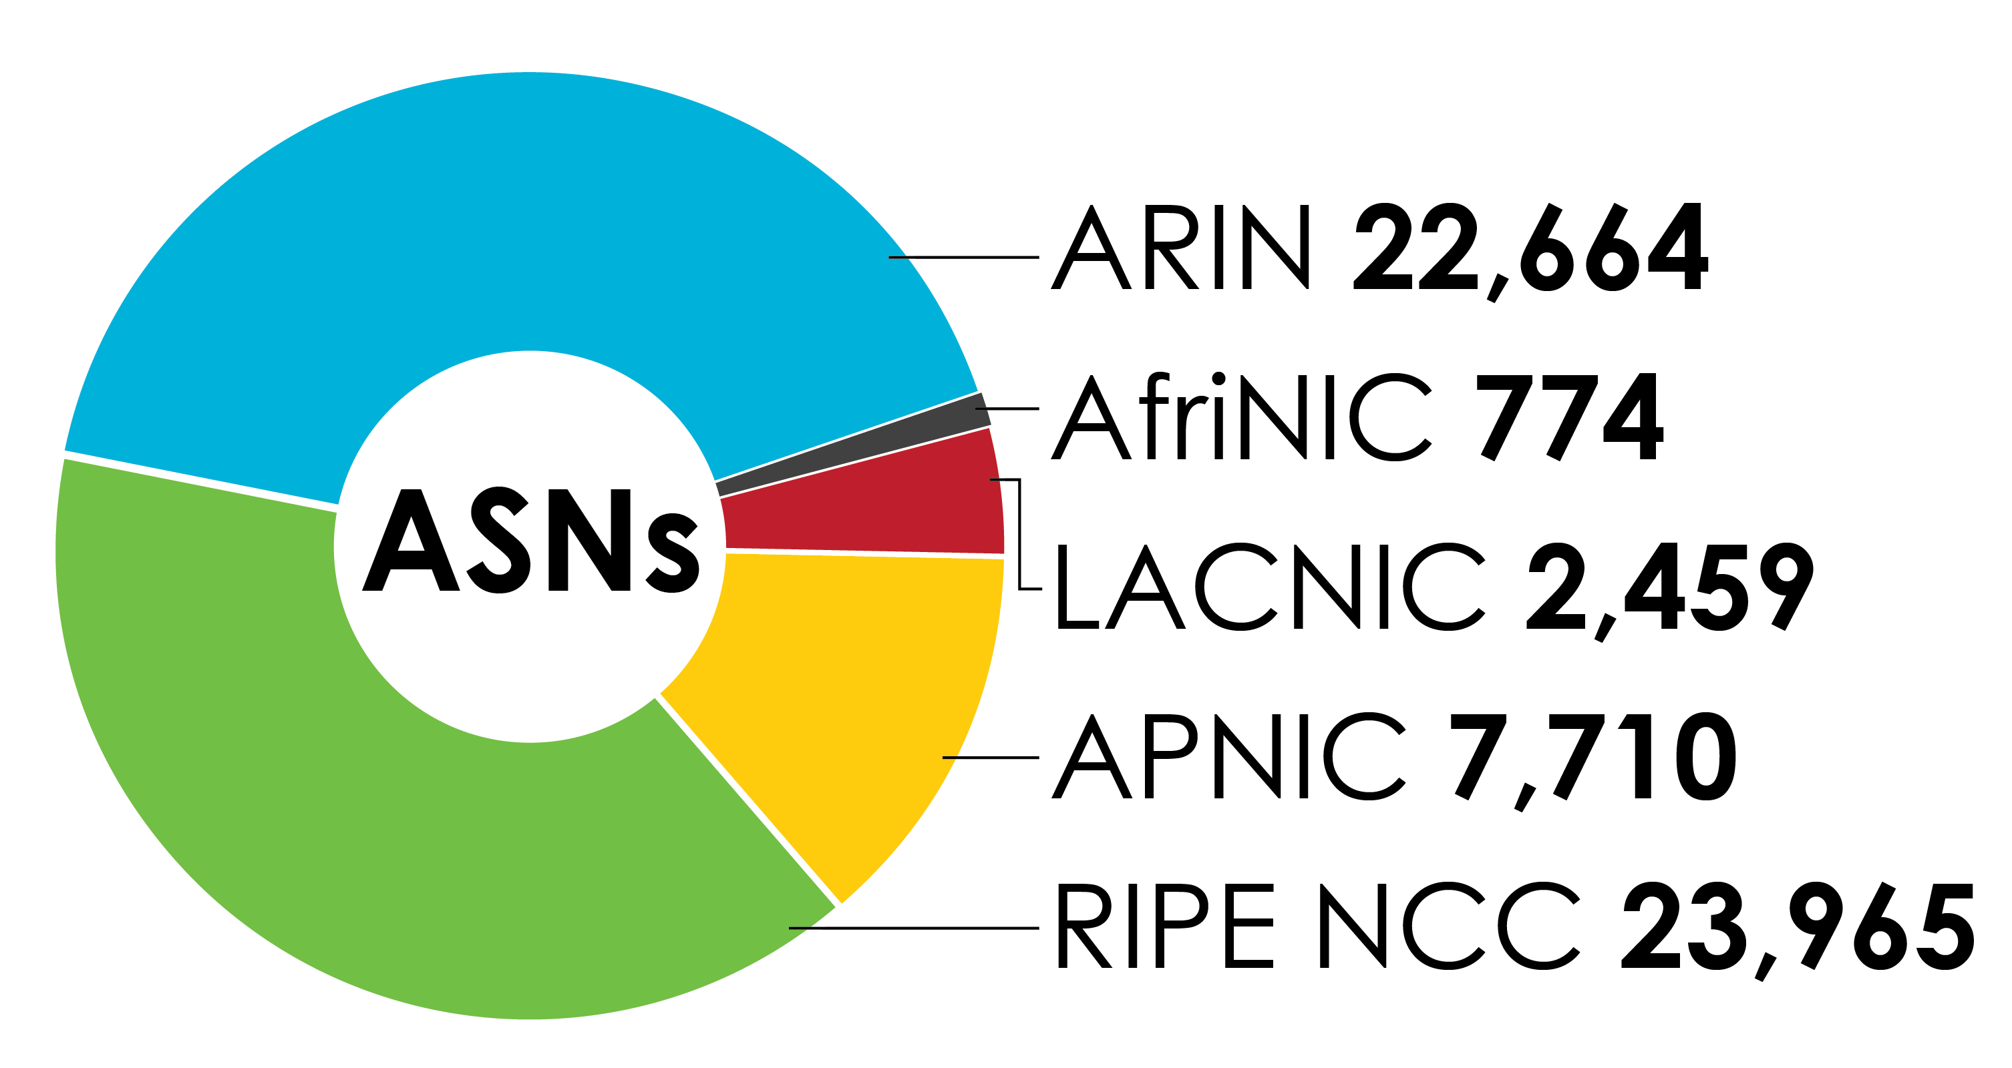
ASN Assignments (RIRs TO CUSTOMERS)
How many total ASNs has each RIR assigned?
(Jan 1999 – Dec 2011)

Slide 42
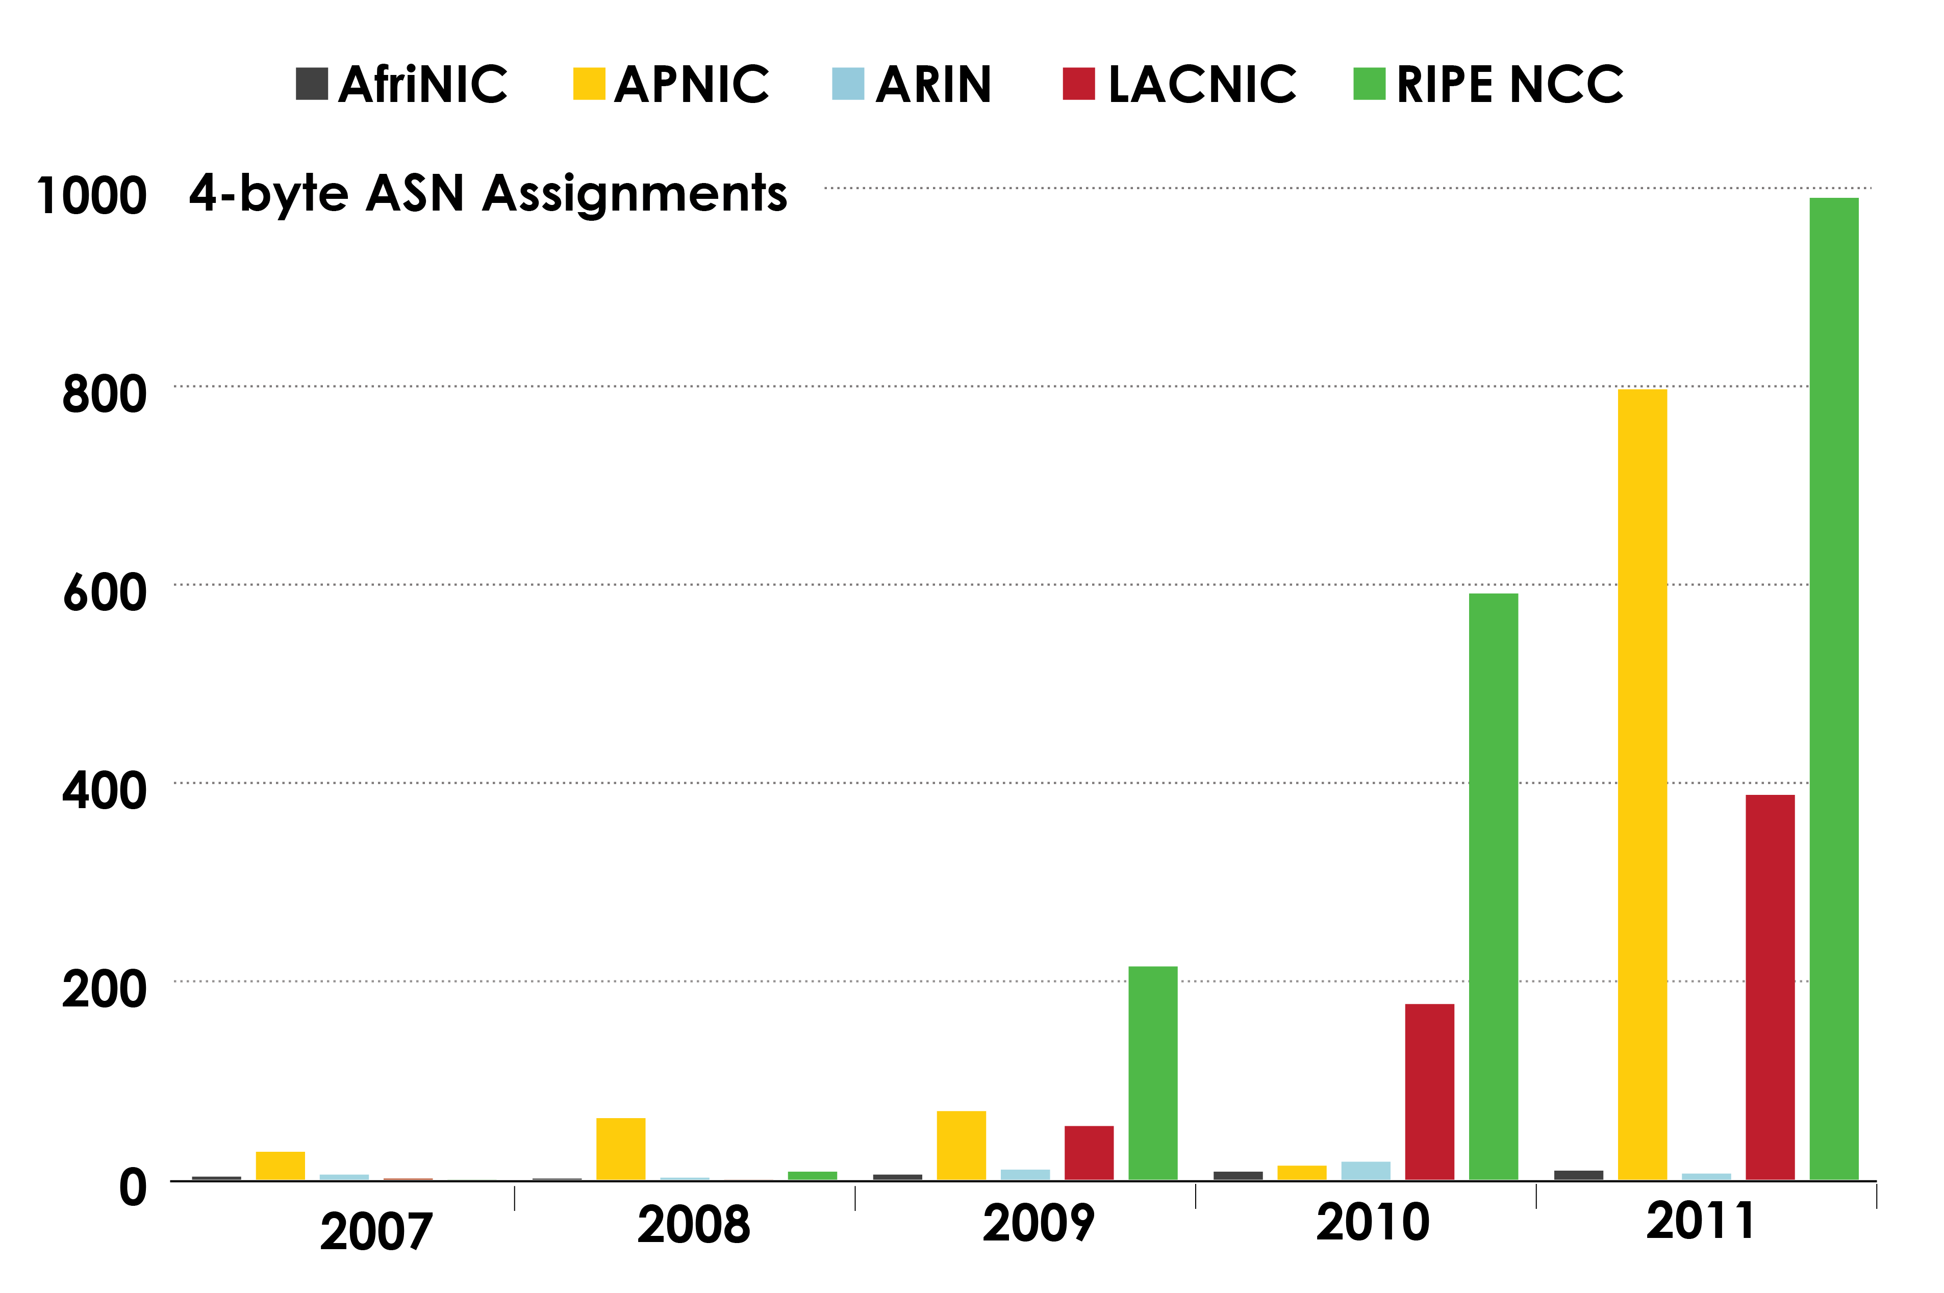
4-BYTE ASN ASSIGNMENTS
How many 4-byte ASNs has each RIR assigned by year?

Slide 43
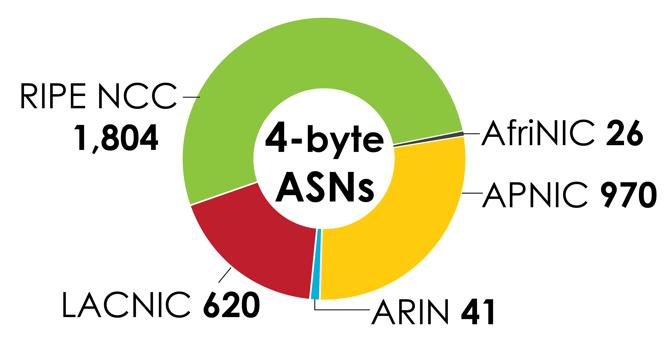
4-Byte ASN Assignments
How many total 4-byte ASNs has each RIR assigned?
(Jan 2007 – Dec 2011)

Slide 44
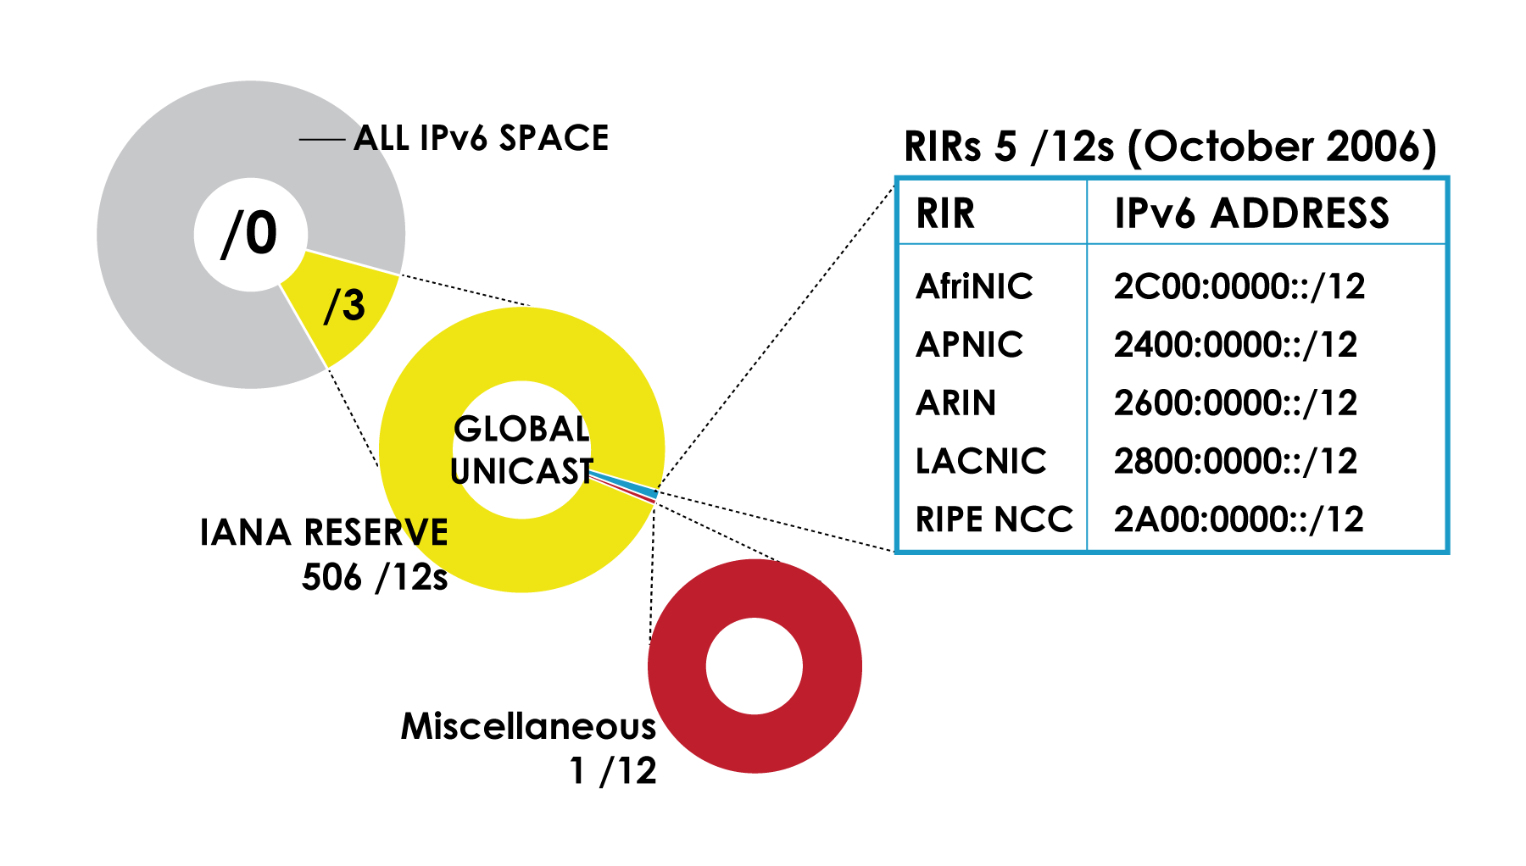
IPv6 Address Space
How much has been allocated to the RIRs?

Slide 45
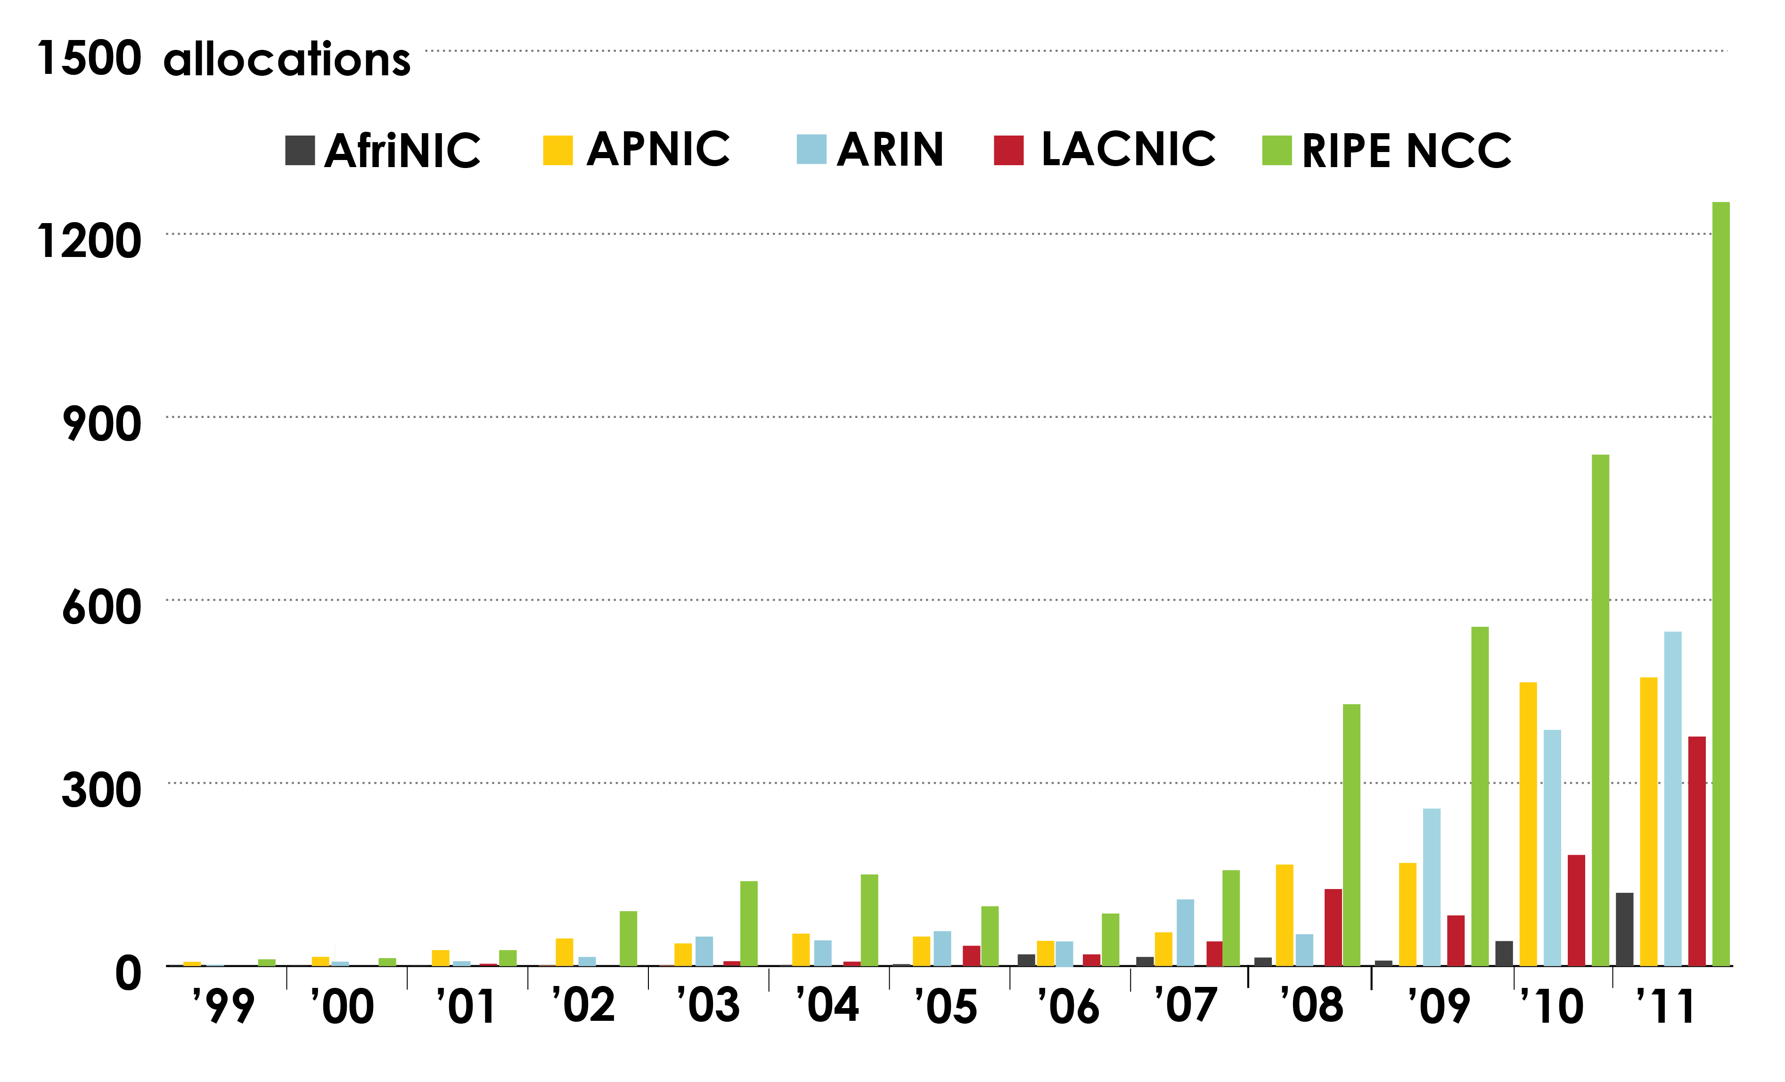
IPv6 Allocations RIRs to LIRs/ISPs
Allocations made by each RIR by year?

Slide 46
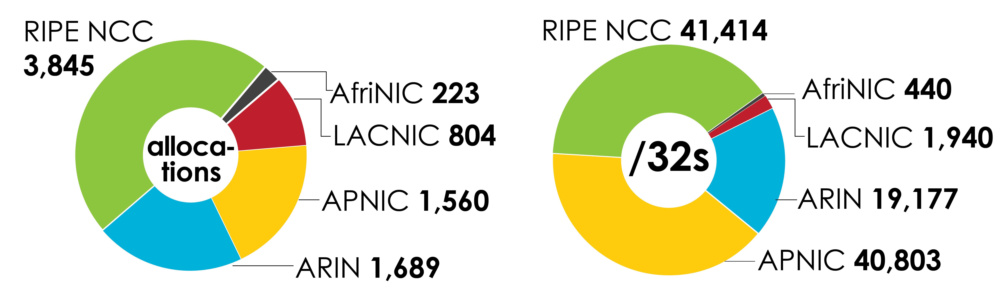
IPv6 Allocations RIRs to LIRs/ISPs
(Jan 1999 – Dec 2011)
How many total allocations have been made by each RIR?
In terms of /32s, how much total space has each RIR allocated?

Slide 47
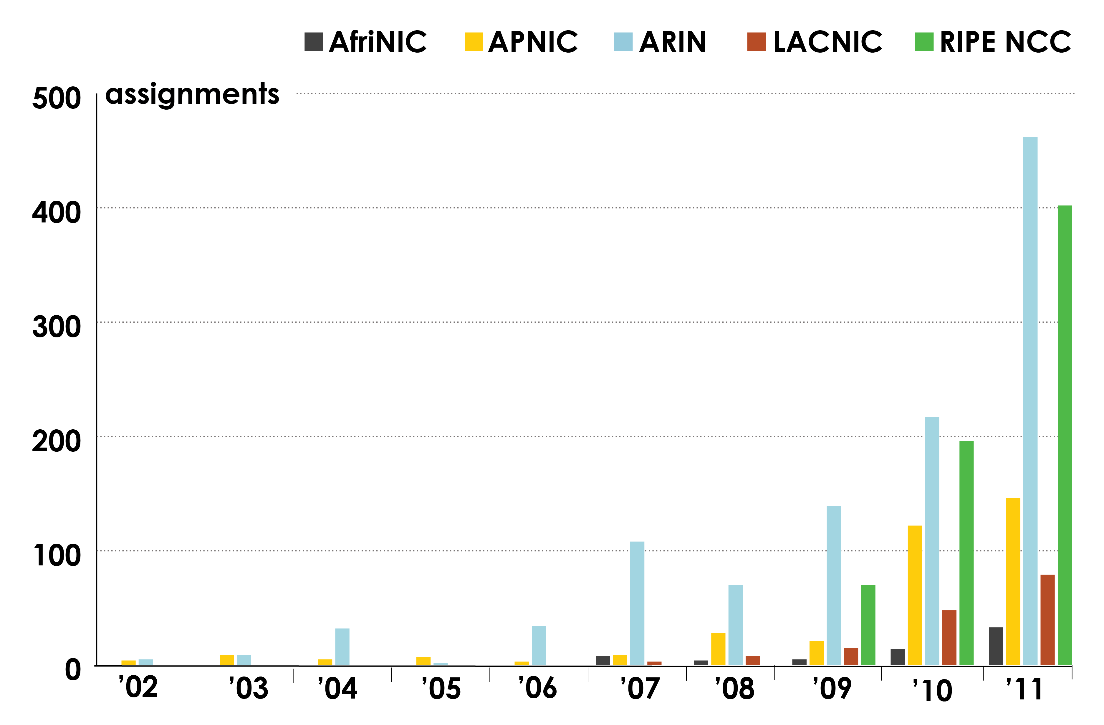
IPv6 Assignments RIRs to End-Users

Slide 48
Links to RIR Statistics
RIR Stats:
  www.nro.net/statistics
Raw Data/Historical RIR Allocations:
  www.aso.icann.org/stats
  www.iana.org/assignments/ipv4-address-space
  www.iana.org/assignments/as-numbers
  www.iana.org/assignments/ipv6-unicast-address-assignments

Slide 49
IPv4 Free Pool Exhaustion
John Curran
Chair NRO EC, President & CEO ARIN
ICANN 43
San Josė, Costa Rica
14 March 2012

Slide 50
IPv4 Free Pool
AfriNIC = 4.3439 /8s
APNIC = 1.1943 /8s
ARIN = 5.5964 /8s
LACNIC = 3.8607 /8s
RIPE NCC = 2.7270 /8s
Source: IPv4 Address Report http://www.potaroo.net/tools/ipv4: As at 13 March 2012

Slide 51
Source: IPv4 Address Report http://www.potaroo.net/tools/ipv4: As at 13 March 2012

Slide 52
Outreach
John Curran
Chair NRO EC, President & CEO ARIN
ICANN 43
San Josė, Costa Rica
14 March 2012

Slide 53
RIRs Conduct Training
Face-to-face
  Training
  Workshops
  Seminars
  Roadshows
eLearning
  Interactive webinars
  Self-paced learning modules
Collaboration
  NOGs
  Training organizations and Universities

Slide 54
RIR Outreach Activities
Roundtables, workshops, representation
  International Telecommunications Union (ITU)
  Organisation for Economic Cooperation and Development (OECD)
  Asia-Pacific Economic Cooperation (APEC)
  Inter-American Telecommunications Commission (CITEL)
  Caribbean Association of National Telecommunication Organizations (CANTO)

Slide 55
The Seed Alliance
New umbrella alliance
  To promote innovation and social development
Funding by
  International Development Research Centre (IDRC)
  AfriNIC
  APNIC
  LACNIC
RIR Partners
  APNIC (ISIF)
  LACNIC (FRIDA)
  AfriNIC (FIRE) new grants program
Seed Alliance Launch on 31 March 2012

Slide 56
Thank you.
Questions?

